Slide 2
What they do
The aim of Irish Aid’s programme is to reduce poverty and hunger, particularly in sub-Saharan Africa where the needs are great.
Irish Aid works in eight countries on behalf of Irish people making better futures for the worlds poorer countries.
Irish Aid also gives Government money to non-governmental organisations like Concern, Trócaire, Red Cross and Goal

Slide 3
About Them
Irish Aid is the Irish Government programme for overseas development.
The work we do in fighting global poverty and hunger is integral to Irelands foreign policy.
It gets its funding from the Irish Government

Slide 4
Its key partner countries
Irish Aid’s key partner countries are:
Ethiopia, Lesotho, Malawi, Mozambique, Sierra Leone, Tanzania, Uganda, Vietnam, Zambia, Liberia, Palestine, South Africa, Timor Leste and Zimbabwe

Slide 5
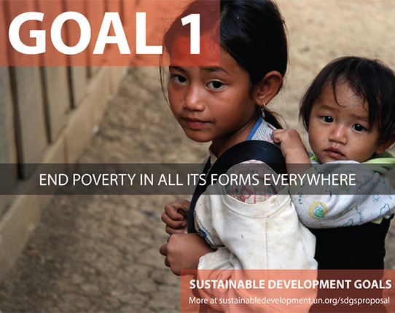
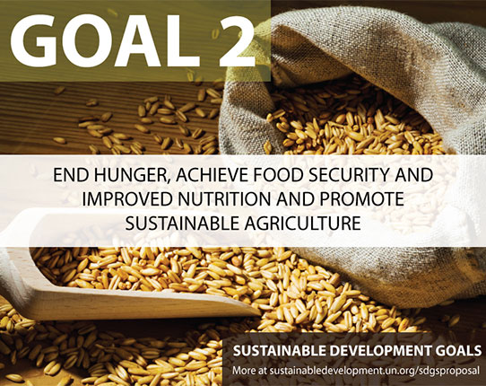
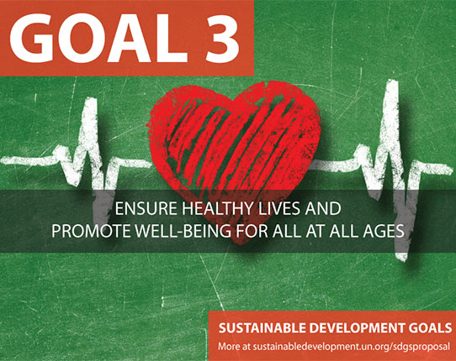
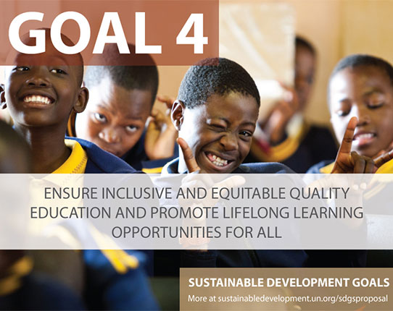
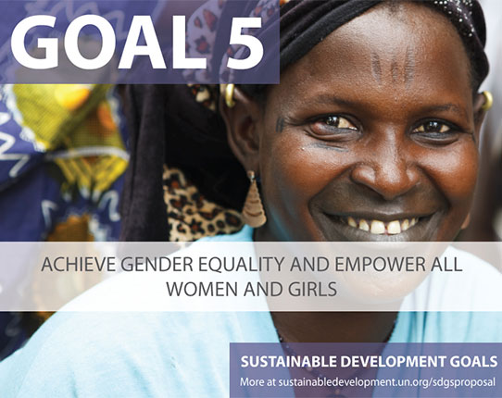
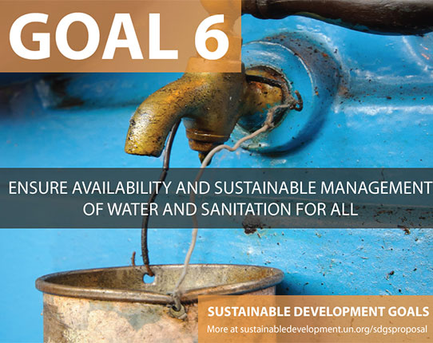
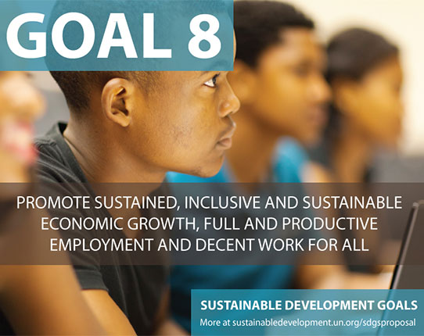
Goals

Slide 6
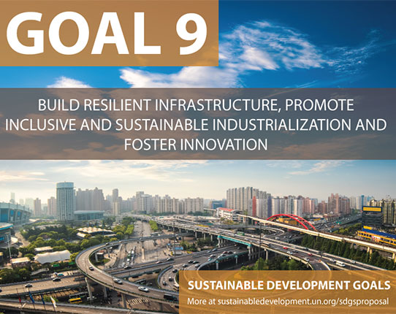
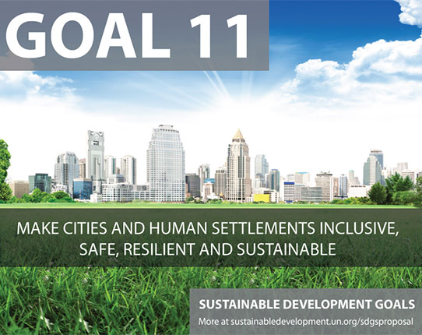
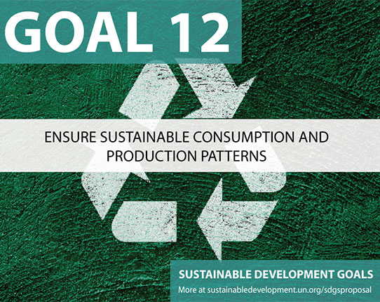
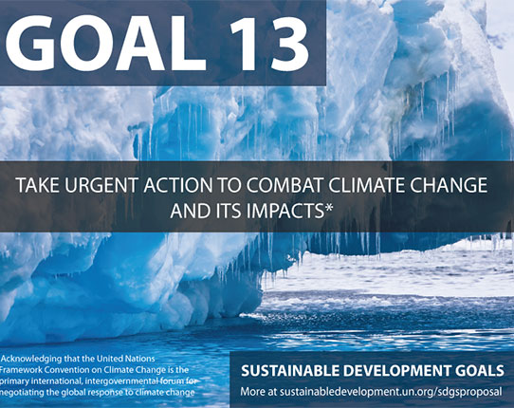
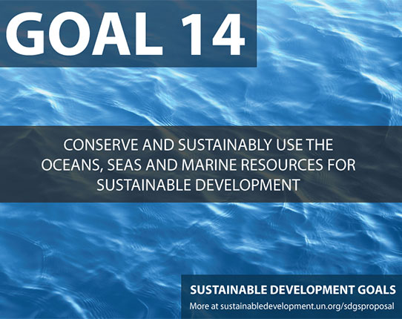
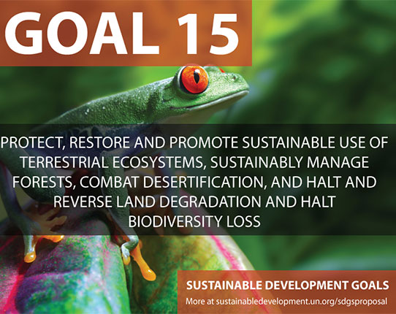
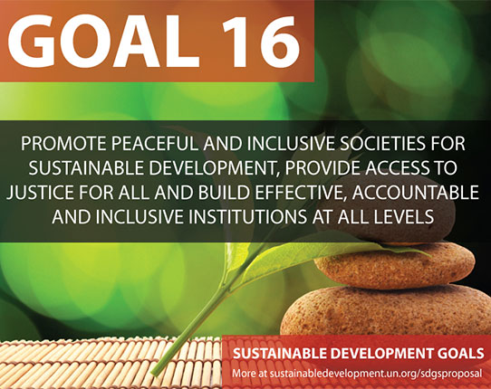
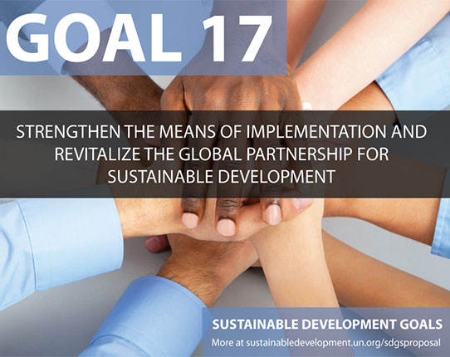
More Goals

Slide 7
Members Of The EU &UN
Ireland’s membership of the European Union helps EU to reduce world poverty
Ireland’s UN membership helps widen reach of the development programme
International financial Institutions use global reach technical knowledge

